Slide 1
Demagnetization Detection Functions
25/10/2018
Simone Ferrari (simone.ferrari@polito.it)

Slide 2
Content
Demagnetization functions
Results example
Comments

Slide 3
Demagnetization Functions
There are 3 functions:
demagnetizationDetectionPoint_v2
Runs the analysis at constant temperature, for a vector of current from 0 to Imax, with ncur points
Each point is analyzed in two rotor positions
The critical machines are saved in the respective folder
demagnetizationCurrentTemperature_v2
Runs iteratively the first function on all the temperatures contained in the PMs properties
The results from the single analysis are available, as well as a general structure
The maximum current to keep health PMs versus the PMs temperature is computed
plotDemagResults
Show the portion of demagnetized PMs for a given current and temperature
The first two functions can be runned
Without inputs: two GUI will ask to pick the machine model and the data (maximum current, number of current point and temperature)
With all the data in the setup structure

Slide 4
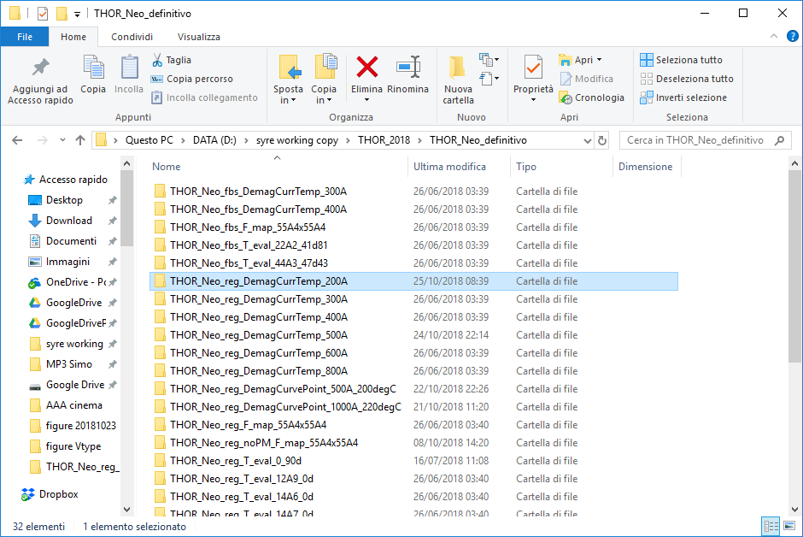
Results example
Result from the current-temperature analysis
200A is the maximum current

Slide 5
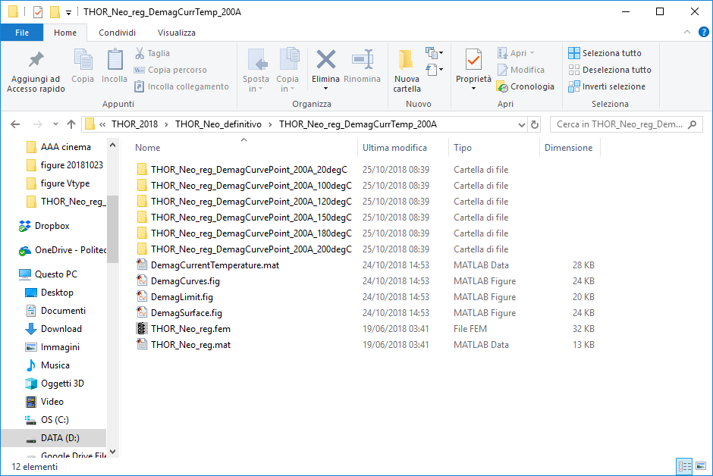
Results example
Each folder is the result of a single temperature analysis
DemagCurrentTemperature.mat contain all the relevant data
Three pictures:
Max current VS temperature
% of demagnetized magnet against current
% of demagnetized magnet against current and temperature (3D surface)

Slide 6
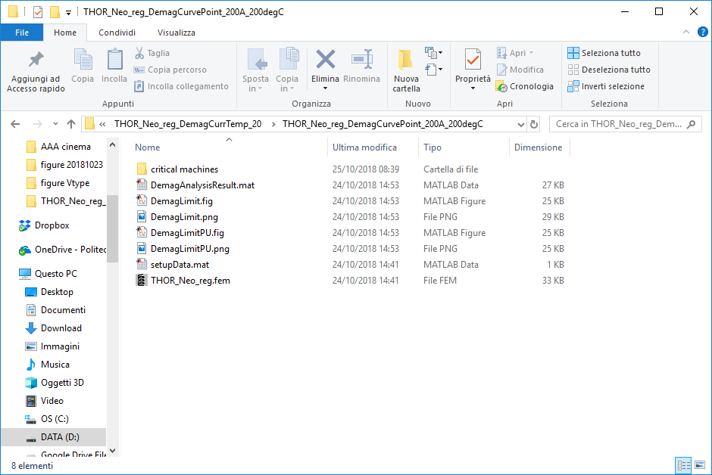
Results example
Critical machines contain the .fem, .ans and .png of all the critical point (at least one node below Bd)
DemagAnalysisResult.mat contain all the relevant data
Two pictures:
% of demagnetized magnet against current
Minimum PM flux density against current

Slide 7
Comment
Slow function:
Extraction data from FEMM
Current start from 0, with constant step
Possible improvements
Use the parallel computation on the inner cycle (current). At the moment is possible just on the outer cycle (temperature)
Different current input. E.g. start from a certain current level and not zero
Add function in SyR-e
Post processing window, add one pop-up (similar to FEAfix number) with
FEMM – single point
FEMM – map
Magnet – single point
Magnet – map
Demagnetization – single temperature
Demagnetization – map
The maximum current and the current steps can be easily taken from curr load and n_grid

